Slide 1

Bike Sharing Demand Analysis Project
Using Excel
NextHikes IT Solutions
Presented by : Abhishek Vagadiya

Slide 2
About Us
At Next Hikes IT Solutions, we present new automated and web solutions to aid you take your commerce to the next stage. Whether you desire a marvellous website, a strong app, or a custom operating system, we have the proficiency and contacts to transfer it.
Startups to large enterprises seeking to enhance their digital footprint and operational efficiency

Slide 3
Project Introduction
This project analyzes bike-sharing demand using Excel to understand the impact of weather, time, and holidays on rentals using analytical tool to import, clean, merge, and analyze multiple datasets collected at hourly and daily levels Multiple datasets are cleaned, merged, and analyzed using advanced Excel techniques such as pivot tables, dashboards, and VBA automation.
The objective is to generate actionable insights and automated reports that support efficient business decision-making.

Slide 4
Problem Statement
Understand how weather, time, and holidays affect bike rentals
Analyze bike-sharing demand using Excel
Use insights to improve business planning and decisions

Slide 5
Dataset Overview
Merged Excel dataset from multiple sources
Hourly & daily bike rental data
Total Records: 390

Slide 6
Project Workflow (NextHikes)
Data Import
Cleaning
Merging
Automation
Dashboard
Analysis

Slide 7
Project Workflow & Excel Methodology
Excel Foundations Used
Sorting, filtering, formatting
Data Cleaning & Merging
Conditional Logic & Lookups
IF statements for classification
Advanced Data Analysis
Pivot tables & pivot charts
SUMIF, COUNTIF, CORREL
Demand trend analysis
VLOOKUP / INDEX-MATCH
Derived analytical columns
Imported datasets into Excel
Handled missing & duplicate values
Basic formulas: SUM, AVERAGE, COUNT
Conditional formatting
Merged using common keys

Slide 8
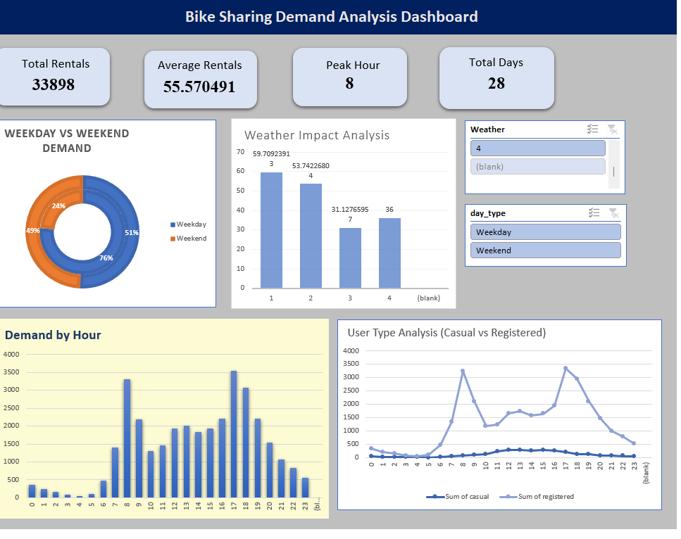
Excel Dashboard
This dashboard summarizes bike-sharing demand across time, weather, and user segments. It highlights peak commuting hours, higher weekday usage, strong dependence on weather conditions, and dominant contribution from registered users.

Slide 9


